Slide 1
Generative Models

Slide 2
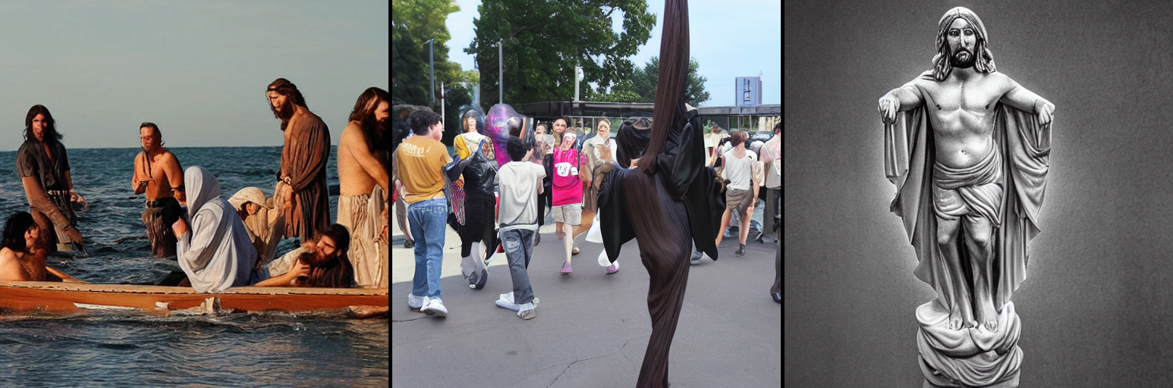
What (one) prompt generated these images?

Slide 3
Warm-up
Recall that a language model outputs a discrete probability distribution over tokens, conditioned on all prior tokens.
How can we use a LM to generate a sentence?
How could we adapt that approach to generate an image?

Slide 4
Links to have open
GANSpace
GAN Lab
GANpaint
https://j.mp/cam2head

Slide 5
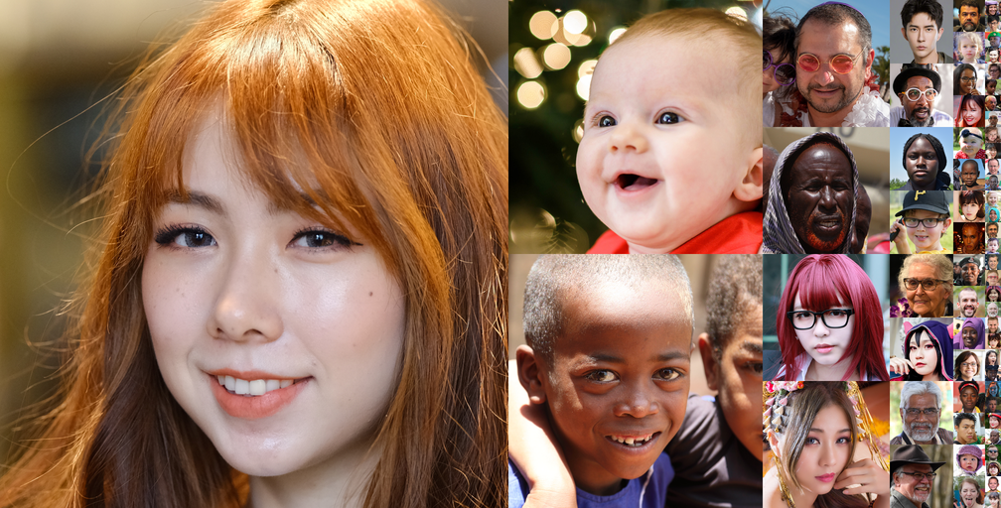
What’s the difference?

Slide 6
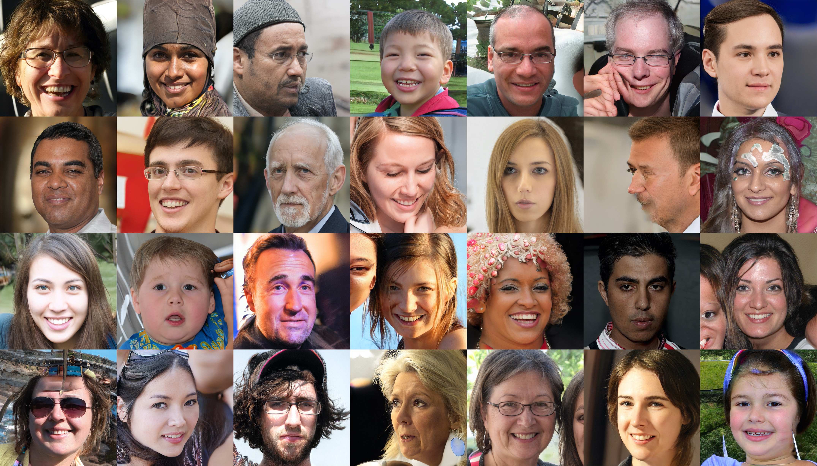

Slide 7
Which was real?
First slide: FFHQ dataset (https://github.com/NVlabs/ffhq-dataset)
Second slide: mid-training snapshot of fine-tuning StyleGAN2

Slide 8
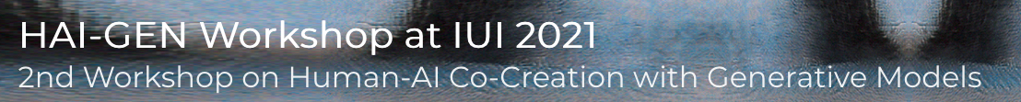
Today: Generation
One approach: LMs.
Today: alternatives
Applications examples: HAI-GEN workshop
Platform game level generation
3D animal shapes
Controlling an instrument with your voice g.co/tonetransfer
Generating documentation for Jupyter notebooks

Slide 9
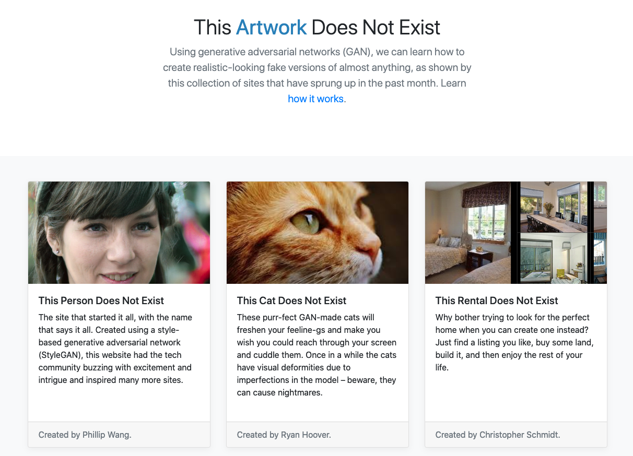
https://thisxdoesnotexist.com/

Slide 10
How might an AI generate an image?

Slide 11
Goal: Why can generative models work?
For details on how, see the readings for this week
What about the world makes this work?

Slide 12
Main Ideas Today
Real things occupy a tiny portion of the space of all possible things.
Images, sentences, sounds, etc.
We can describe that tiny space as a distribution
We can compose learned functions in various ways to model that distribution

Slide 13
Real things occupy a tiny portion of the space of all possible things.
Natural images are a small subset of all possible images

Slide 14
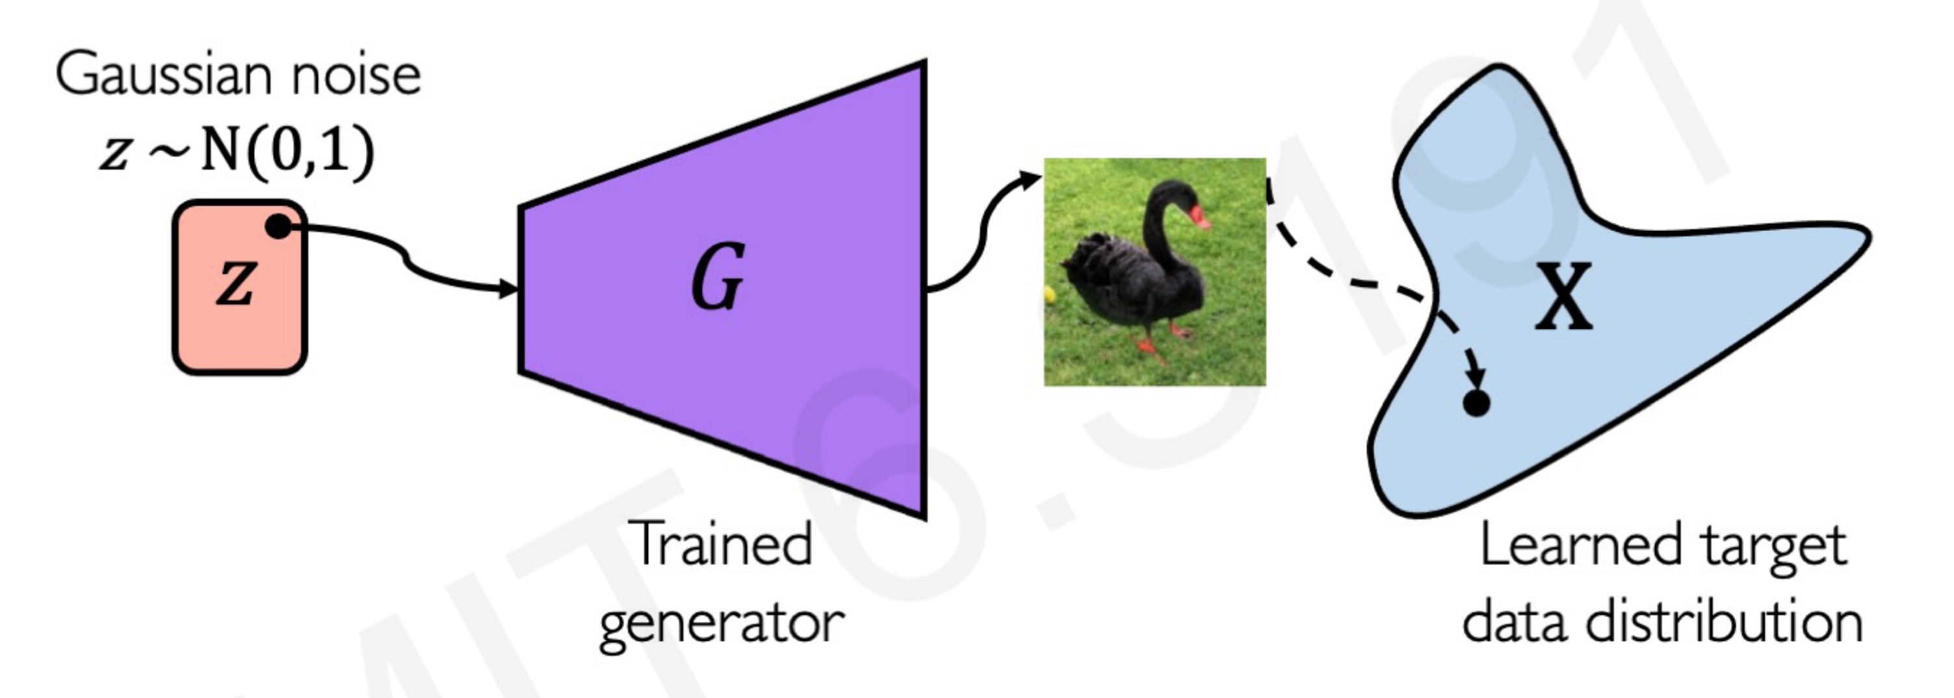
Generator Network
Demo: https://observablehq.com/@stwind/latent-flowers-ganden
http://introtodeeplearning.com/slides/6S191_MIT_DeepLearning_L4.pdf

Slide 15
How to compose functions to model distributions?
And how do we train those functions??

Slide 16
Ways of modeling distributions
Single decisions (softmax classifier)
Sequential decisions (autoregressive)
Latent variables
Diffusion-based

Slide 17
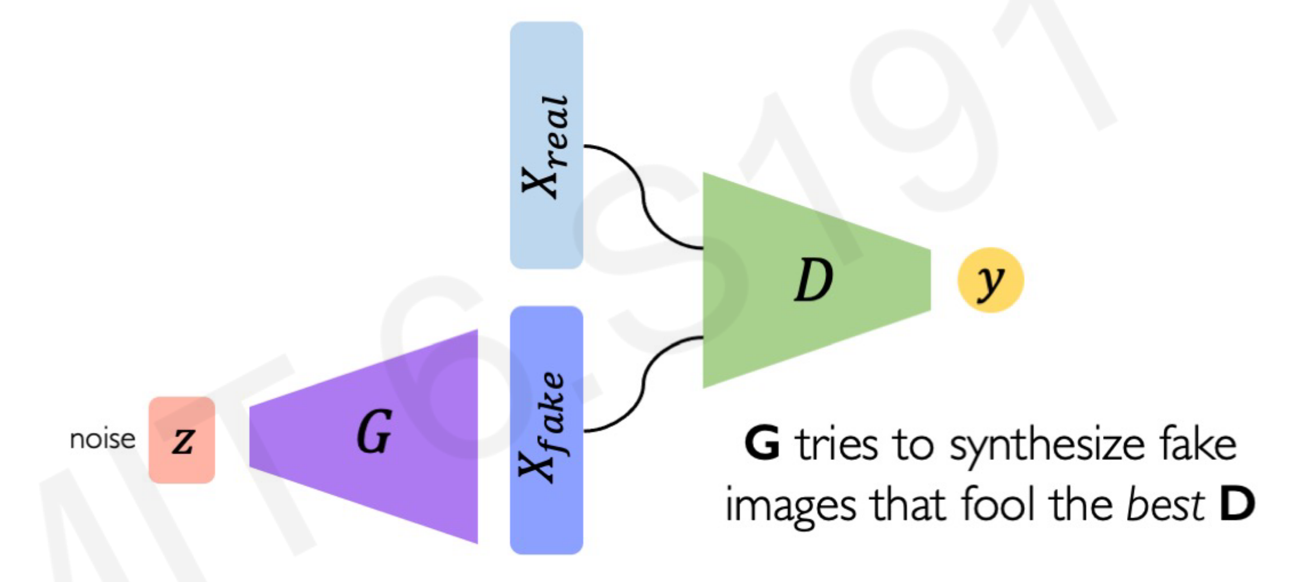
Generative Adversarial Network
Try it at GANLab

Slide 18
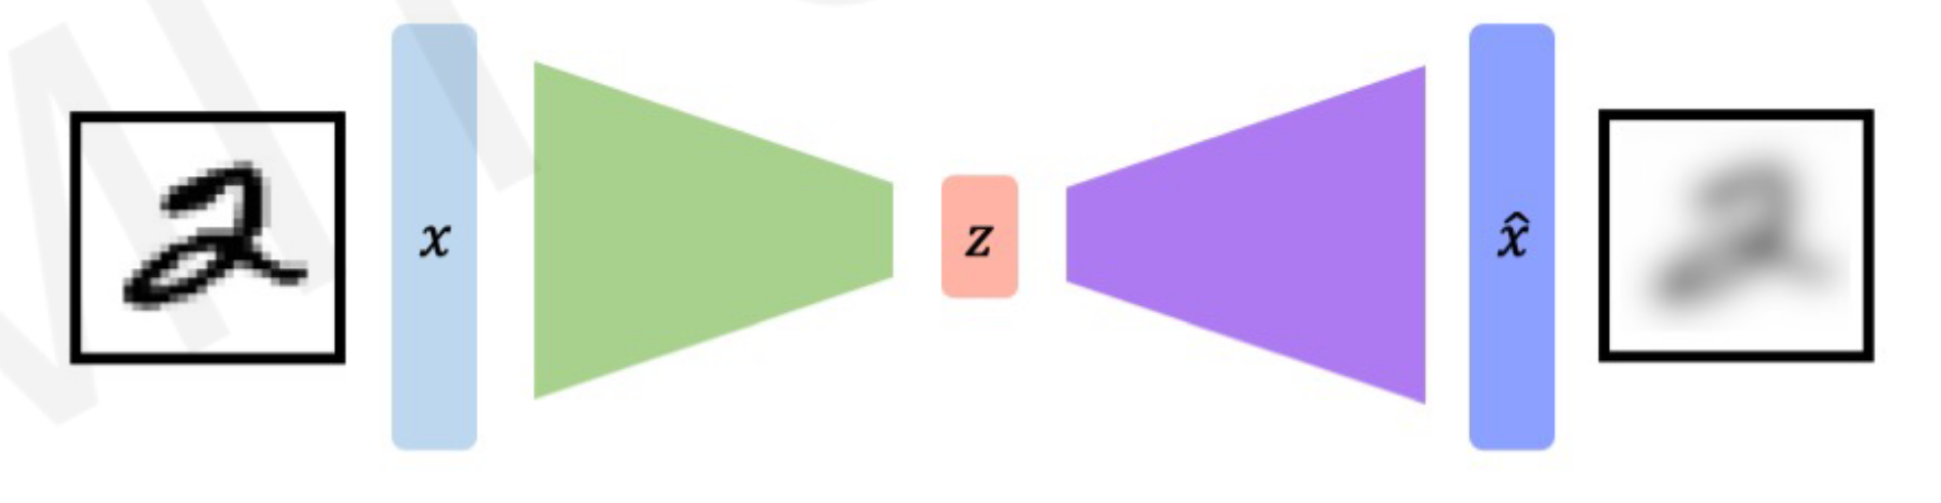
Autoencoder
Reconstruction Loss: output minus input
Encoder E
Decoder D
http://introtodeeplearning.com/slides/6S191_MIT_DeepLearning_L4.pdf

Slide 19
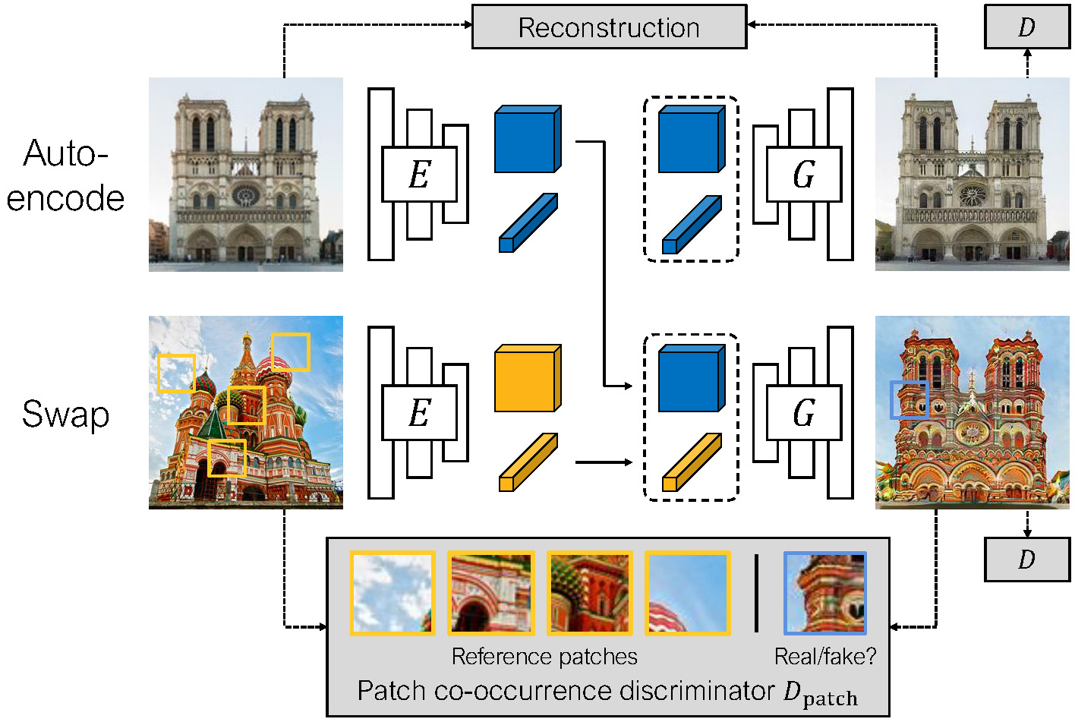
Swapping Autoencoder
https://taesung.me/SwappingAutoencoder/

Slide 20
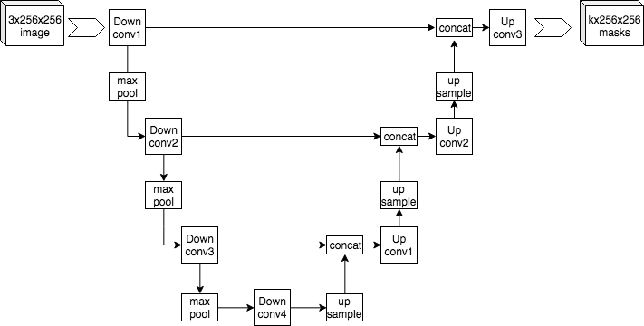
U-Net
https://commons.wikimedia.org/wiki/File:Example_architecture_of_U-Net_for_producing_k_256-by-256_image_masks_for_a_256-by-256_RGB_image.png

Slide 21
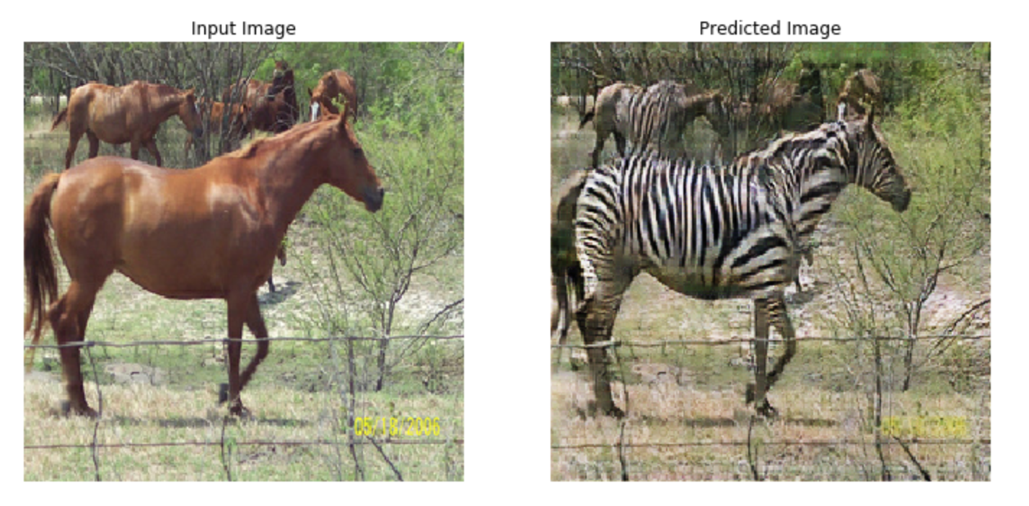
CycleGAN (image <-> image)
https://www.tensorflow.org/tutorials/generative/cyclegan

Slide 22
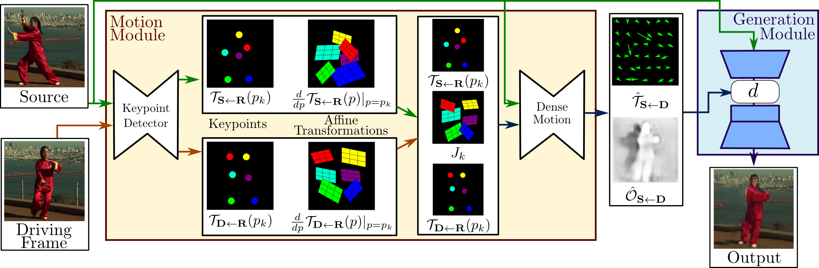
You don’t need all this for a simple deepfake
https://aliaksandrsiarohin.github.io/first-order-model-website/
Demo: https://github.com/eyaler/avatars4all

Slide 23
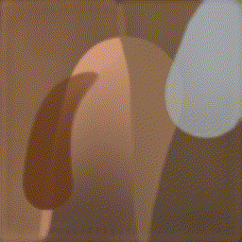
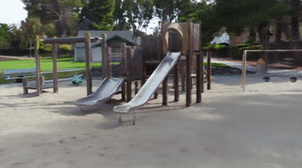
Many other creative approaches
Learning to draw an image stroke-by-stroke
PaintBot / https://arxiv.org/abs/1904.02201
Model-based RL: https://arxiv.org/abs/1903.04411
Interactive image editing (GANPaint)
Controls (e.g., GANSpace)
Use a sequence model (Transformers)
https://compvis.github.io/taming-transformers/
Neural Rendering (NeRF)
https://github.com/Kai-46/nerfplusplus
https://github.com/yenchenlin/awesome-NeRF

Slide 24
Applications
Video conferencing
Background segmentation (e.g., virtual backgrounds)
regenerate the face on the client side (e.g., NVIDIA Maxine)
Sim2real: train robots in simulations that perform well in real world
Super-resolution, image/sound restoration
Inpainting: remove distracting objects (now in Photoshop)
Anomaly detection (e.g., tumor detection)
Causal inference

Slide 25
Practical tips
Use pre-trained models
Use battle-tested code
Start with already-running code and tweak it
Consider other approaches besides GANs:
VAEs like https://github.com/openai/dall-e or Taming Transformers
https://github.com/lucidrains/DALLE-pytorch
CPPNs

Slide 26
Perspectives and Ethical Considerations

Slide 27
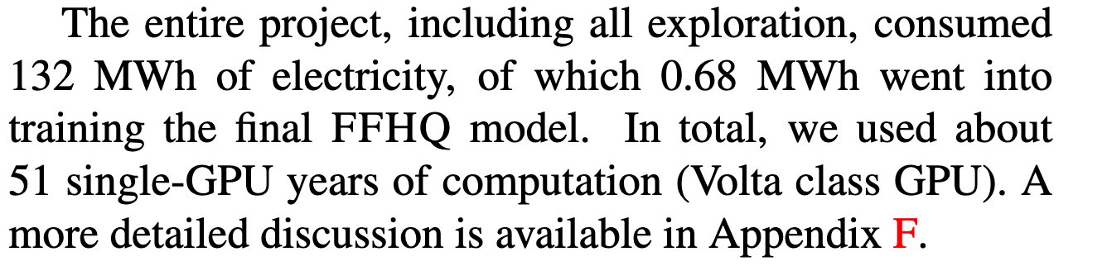
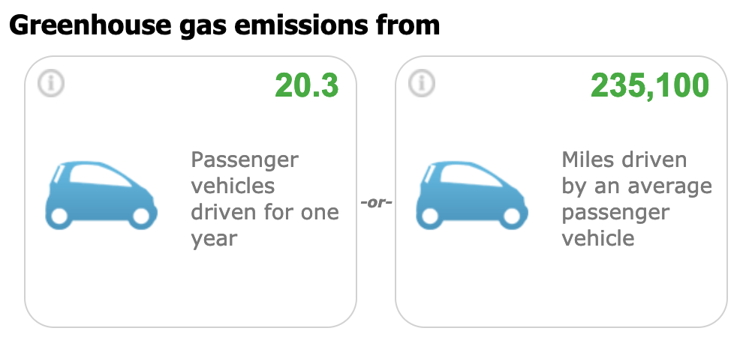
StyleGAN2’s Energy Cost
https://arxiv.org/abs/1912.04958
https://www.epa.gov/energy/greenhouse-gas-equivalencies-calculator

Slide 28
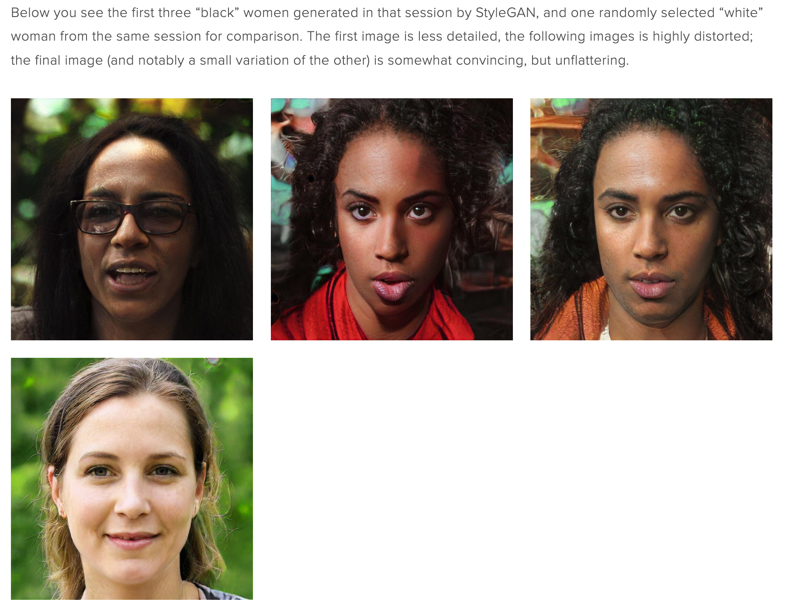
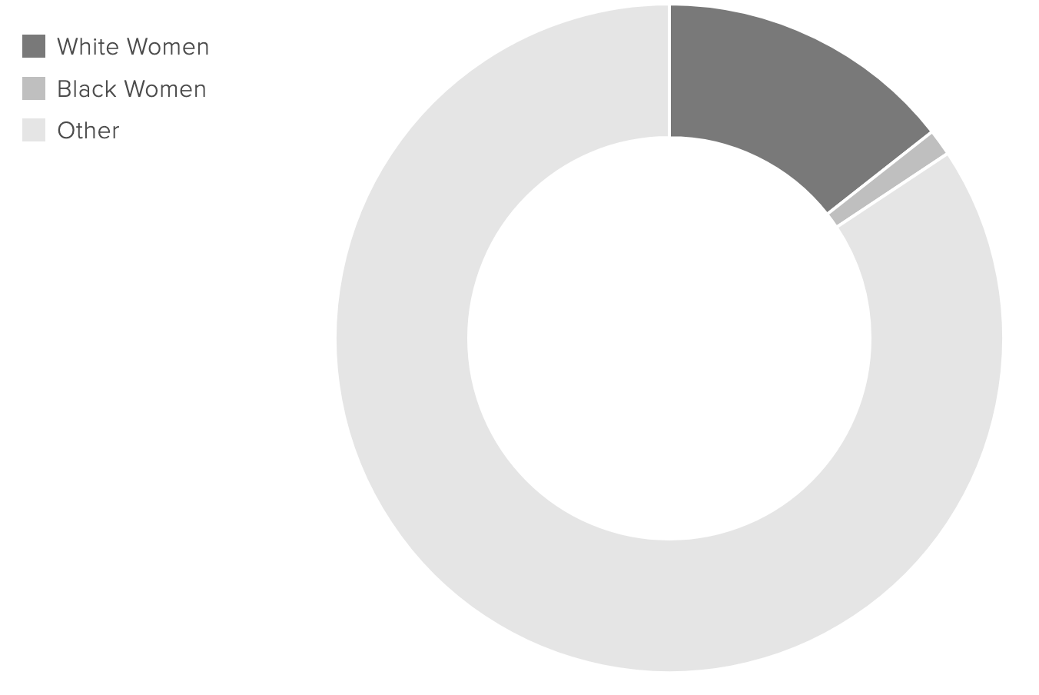
https://www.intersectsy.com/intersectsy/2019/10/3/what-i-learned-about-bias-from-the-first-ai-generated-faces-on-wikimedia-commons

Slide 29
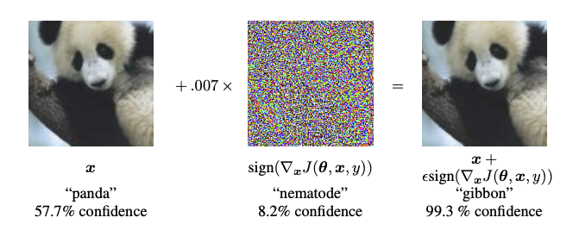
Adversarial Examples
Generating an image to fool a classifier
https://www.tensorflow.org/tutorials/generative/adversarial_fgsm

Slide 30
Who owns the image? Who owns the model?

Slide 31
Other questions?

